Slide 1
课后练习答案+Text B

Slide 2



LOGO
Unit 1

Slide 3
Reading Comprehension-Exercise 1
1) a) sniffed at; smug; b) C
2) a) the few remaining holes; quite soon; b) C
3) a)impossible to be truly alone; more and more endangered; need a new plan; b) D

Slide 4
Reading comprehension-Exercise 2
1) GPS 2) clean break 3) alone 4) off the grid 5) bizarre attempts 6) Internet access 7) account 8) enhance 9) live with 10) persistent

Slide 5
Reading comprehension-Exercise 3
1) “It” refers to the practice of taking an intentional break from civilization and technology. The author implies that the more advanced technology people have, the more they want to escape.
2) 远离科技也是“火人”反传统狂欢节的众多亮点之一（不过这些来到这片干涸湖床的狂欢者们越来越愿意并能够在Instagram或推特上共享他们在沙漠中的刺激冒险）。

Slide 6
Reading comprehension-Exercise 3
3) We can’t seek the feeling of being alone or being free of distraction by hiding ourselves in a remote or deserted place. What we should do is create our internal peace by adapting ourselves to the changing circumstances.
4) Because it is hard to draw the line between what is technology and what is not.
5) The author thinks that the phone is not the root cause of people’s obsession because it is only a tool; while we, the users, are to blame because we lack the self-discipline.

Slide 7
Language in Use
4. 1) sniffing 2) definition 3) intentional 4) urgent 5) smother 6) endangered 7) bizarre 8) distractions 9) pointless 10) discipline
5. 1) draw the line; have a point
2) relying on; living with 3) temporary break; serves up; gaze up at; Resist the urge
6. 1) sniffed at 2) grumbling at 3) rejoice at 4) grasp at 5) Glancing at 6) marveling at 7) aim at 8) barked at

Slide 8
Language in Use
7. 1) packed with 2) consisting with 3) endowed with 4) quivering with 5) combined with 6) gossip with 7) compromise with 8) paled with
8. Reference translation
1) 我们走了200多英里都没有踏足任何公路——更爽的是，这期间我们没有处理任何电话、电子邮件、推特或其它日常网络通信。这简直就是人间天堂。

Slide 9
Language in Use
8. Reference translation
2) 但当我们走到小路尽头，站在惠特尼山巅，俯瞰这广阔无垠的美国西部时， 随处可见的只能手机让我惊愕不已。
3）每个人对何为彻底逃离（科技）都有自己的定义。在某些人看来，我所谓的彻底逃离其实并不彻底。
4）现在的情形已疾病如此了。只消上网看看国家电信和信息管理局的全美宽带覆盖图，你就会发现，除了一些高山和人烟稀少的沙漠外，全国基本呈纯蓝色。
5）这些例子也许荒诞可笑，但却发人深省。我们生活在一个非凡的年代，在这个年代里，真正的独处很快将难以实现。

Slide 10
Language in Use
9. Reference translation
In an increasingly modernized society, Bhutan’s unique development philosophy deserves our research and reflection. As the last country that is open to TV and the Internet, Bhutan’s mobile phone and Internet penetration are as low as 30% and 5% respectively, seemingly out of tune with the modern world. While other countries are striving to develop economy and boost GDP at all costs, what Bhutan pursues is GNH (Gross National Happiness). Bhutan believes that happiness consists in sensible restraint on desire to strike a balance between the material and the spiritual, modernity and tradition, economic growth and sustainable development. They are willing to take advantage of modern technology, but would do so at their own pace, according to their own needs and at their own proper time. Although likewise thirsting for economic prosperity, Bhutan refuses to realize it at the price of their cherished traditional culture and environment sustainability.

Slide 11
Text B Generation Me: The Millennial Generation's Obsession with Being Unique
Question 1 What is the tone of paragraph 2?
Objective.
Question 2 What is the main idea of paragraph 2?
People show love to their mothers online on Mother's Day.

Slide 12
Text B Generation Me: The Millennial Generation's Obsession with Being Unique
Question 3 What is the tone of paragraph 6?
Subjective.
Question 4 What’s the main idea of paragraph 6?
It is uncertain whether the pursuit of originality is the cause or consequence of our generation’s alienation.

Slide 13
Text B Generation Me: The Millennial Generation's Obsession with Being Unique
Question 5 How did the members of the Millennial Generation maintain an attitude of being unique?
They maintained an attitude of being unique by making consumption decisions to stand out.
Question 6 What are the distinguishing features Millennials possess when compared with Generation X and the Baby Boomers?
Millennials are more civically and politically disengaged, more concerned with materialistic values and less interested in helping the larger community than Generation X and the Baby Boomers.

Slide 14
Text B --- Exercise 1
1) a) objective; b) People show love to their moms online on Mother’s Day.
2) a) subjective; b) The influence of technology is admittedly an important factor, but it is also true that the Millennial Generation is more obsessed with individualism than ever.
3) a) subjective; b) It is uncertain whether the pursuit of originality is the cause or consequence of our generation’s alienation.
4) objective; b) It is reported that Millennials are more materialistic and less socially conscious.

Slide 15
Text B --- Exercise 2
1) conscious
2) profess
3) dilemma
4) alienating
5) prejudice
6) interaction
7) obsession
8) invaluable

Slide 16
Text B --- Exercise 3
1) a) at the cost of b) at the mercy of
c) at the speed of
2) a) in partnership with b) in accordance with c) in connection with
3) a) beyond doubt b) beyond words
c) beyond comparison

Slide 17
Text B --- Exercise 4
A mature and considerate soul tends to be more concerned with how other people react to an issue, rather than how he feels about it himself.
We shall look into the root cause of the failure, and get it resolved once and for all.
The most challenging thing in foreign language learning is to think in the same manner as native speakers.

Slide 18
Text B --- Exercise 4
She is neither pretty nor wealthy. Nevertheless, her independence, sincerity and friendliness make her stand out from the crowd.
Under the influence of the family planning policy, most of the Millennials in China are the only child and the center of the family. They are often brought up in a “4+2+1” family structure, forming a relatively independent and uninhibited personality. The Millennials, growing up in an era of knowledge explosion, are better educated than previous generations, and are more fixated on realizing their own values. Their growth is accompanied by the birth and rapid development of the Internet; the changeable circumstances have cultivated their adaptability to the environment.

Slide 19
LOGO
Unit 2

Slide 20
Exercise 4
utility 2) reject 3) specialized 4) notions
5) dismiss 6) disciplines 7) address 8) stimulate
9) developmental 10) defined

Slide 21
Exercise 5
In the fields of; decide on; buck the trend
centering on; enable…to; view…as
In terms of; a host of

Slide 22
Exercise 6
1) groping for 2) strive for
3) applauded for 4) substitute for
5) compensate for 6) stand for
7) weep for 8) blame for

Slide 23
Exercise 7
1) comment on 2) deciding on
3) elaborate on 4) imposed on
5) concentrate on 6) acts on
7) feed on 8) relied on

Slide 24
Exercise 8
1）接下来的几分钟里，他简要介绍了通识教育的发展历史，告诉学生们
“liberal”一词来自拉丁语，意为“自由”，这种学校教育在古代只有自由的小孩（而非奴隶）才能享受。
2）现代的通识教育让学生接触许多理工和人文学科，这些学科知识有助于深入探求人生重大问题的答案。
3）他们认为，高等教育如果不以培训学生做事挣钱为核心，就是毫无意义的。
4）如果想弄清我们的调查对象究竟做了什么成就了极富成效与创造力的人生，我们就必须理解为什么他们如此重视在选定专业领域之前所接受的通识教育。
5）他们把教育理解为一种成长历程，在此过程中，他们致力于思维能力的提升，这样一种理解也影响到了他们所尝试的学习方向。

Slide 25
Exercise 9
The imperial examination system in China began to be put into practice in the Sui Dynasty and lasted more than 1,300 years. In ancient China, class consciousness was distinct and people from lower classes had little chance to gain a position in the official court. But once the imperial examination system was introduced, scholars from poor families had opportunities to take the government exams, which enabled them to bring honor to their families. Such a talent-selection system had great impact not only on the politics, economy, education, culture concepts and social customs in Chinese feudal society, but also on the education systems of such neighboring countries as Japan, Korea and Vietnam. To some extent, China's current education system has selectively inherited some advantages from the imperial examination system.

Slide 26
Text B A Worried Parent Writes from the UK
Why does the author’s wife suggest their children going to plumbing college?
What was the supposed goal of university in the 1980s in the UK?
Students learn useful and relevant skills there. They become eminently employable. And they probably don’t have tuition loans to pay back.
University was supposed to be about a broadening and deepening of the individual.

Slide 27
Text B A Worried Parent Writes from the UK
What does “this notion (para. 4)” refer to ?
What is the author’s idea about the goal of university?
This notion refers to “one hoped to leave having developed a richer understanding of the universe and one’s own place in it.”
University is there for them to deepen their love of a subject and to develop as individuals.

Slide 28
Text B A Worried Parent Writes from the UK
What is paragraph 10 mainly about?
What is paragraph 13 mainly about?
The author suggests that university students should deepen their love of a subject and develop as individuals.
People’s attitudes toward higher education need changing and the parents should take on the task.

Slide 29
Text B --- Exercise 1
1) pro
Plumbing college clearly has a lot to recommend it. You learn useful and relevant skills there. You become eminently employable. And you probably don't find yourself having £30,000 of tuition fees to pay back when you finally complete the course.
2) con
A humanities student in the 1980s, pursuing a non-vocational course, could still feel confident that the degree he or she was studying was worthwhile in itself. University was supposed to be about a broadening and deepening of the individual.
3) con
Job prospects, employability skills and building networks of “contacts”, must be a secondary or even tertiary concern. Study something that fascinates you, and worry about the future later on.
4) con
Classicists would be able to tell us that Aristotle's concept of “flourishing” as an individual --- eudaimonia --- does not imply material success at all. Living and doing well is what matters. One probably need sot be well educated to achieve this but not necessarily paid an investment banker's salary (or bonus)

Slide 30
Text B --- Exercise 2
1) affordable 2) conscientious
3) synthetic 4) suppress
5) defiant 6) condemn
7)incurred 8) fascinate

Slide 31
Text B --- Exercise 3
1) as far as ... is concerned
2) take on
3) die down
4) in due course
5) may as well
6) go through
7) for the sake of
8) pays off

Slide 32
Text B --- Exercise 4
1）本人是位焦虑的家长，上世纪80年代读的本科，那时关于学生生活的某些真理还是不言自明的，尽管英国当时正经历着一次重大的经济转型。
2）我想我的的确确曾亲耳听到时任首相托尼・布莱尔（他毕业于牛津大学圣约翰学院）宣称“学的越多，挣的也越多”，说这话时他显然没有挖苦之意。
3）一旦政治上的争执和愤慨（不管是真义愤还是伪装的）平息下来，我们所有人将不得不冷静思考如何帮助我们的孩子应付他们终将面对的债务。
4）借贷分期偿还学费的方式与最初用来替代拨款的学生贷款并无二致，可能终将成为年轻人最有用也最能负担得起得贷款。
5）然而，情况也许会是这样：就在20多年前我们很多人都还得到过父母的经济支持，然而随着这个国家里“夹缝中的中产阶级”日益沦落，父母为子女提供经济支持得情况将越来越少见。

Slide 33
LOGO
Unit 3

Slide 34
Exercise 4
1) transformed 2) radically
3) taboos 4) reinforce
5) deny 6) embrace
7) undesirable 8) missions
9) affirming 10) elevating

Slide 35
Exercise 5
1) keep…in perspective; is central to; reflection and introspection 2) personal growth; connect the dots; seek out; unlock the potentials; navigate through

Slide 36
Attributive phrasal modifiers
Exercise 6
1) available to 2) superior to
3) indispensable to 4) sensitive to
5) adverse to 6) beneficial to
7) indifferent to 8) comprehensible to

Slide 37
Exercise 7
1) be productive of 2) expressive of
3) be critical of; be appreciative of 4) is respectful of; boastful of
5) are desirous of 6) be suspicious of
7) was neglectful/negligent of 8) is/was envious of

Slide 38
Exercise 8
1) 尽管他在2011年不幸英年早逝，他的一生仍然完美诠释了个人成长、领导发展和人性潜能实现的过程。
2）乔布斯不仅拓宽了世人对可为之事的想象，还彻底改变了我们对于领导力和创新精神的看法。
3）有些领导者，特别是那些进入领导岗位的人，可能意识不到他们的行为适得其反。
4）他们的幸福感和成就感不仅来自于成功、更来自于这个过程的内在特征。
5）即使结局不尽人意，也可以获得很多经验教训；失败常常正是未来发展的催化剂。

Slide 39
Attributive phrasal modifiers
Exercise 9
作为一名管理者，我曾在四家以激情和创造力著称的企业任职。我很少用一种自上而下的（top-down）方式为每一名员工安排工作。我更愿意将自己与员工放在一个平等的位置上，把自己视作激励者、协调人或沟通桥梁，而非传统意义上的领导者、督促者或命令中心。
As a manager/an administrative officer, I have worked in four enterprises well known for their great passion and creativity. Rarely do I assign tasks for my employees in a top-down manner. I prefer to place myself on an equal footing with my employees, regarding myself as one to motivate, coordinate or communicate with them, rather than a conventional one to lead, monitor or command.

Slide 40
Exercise 9
To Western people, Chinese myths seem to be exceptionally inconceivable. Confronted with raging floods, Yu, drawing lessons from his father’s failure, eventually managed to tame the floods after 13 years of perseverance. Blocked by the big mountains, Yu Gong, instead of moving away, chose to remove the mountains with his family members. Scorched by the ten burning suns, Hou Yi opted to shoot down nine of them, leaving only one to shine upon the earth. These mythical stories essentially embody the struggling spirit of the Chinese nation to have their fate in their own hands rather than that of gods. This unyielding struggling spirit has evolved into a gene of Chinese culture, which has contributed much to making China one of the longest-standing nations in human history.

Slide 41
Text B Be a Better Leader, Have a Richer Life
Question 1 What is a zero-sum game?
It is a situation in which what is gained by one person or group is lost by another person or group.
Question 2 What does “four-way wins” refer to according to the article?
It refers to achieving success in four domains of life --- work, home, community, and self (mind, body, and spirit).

Slide 42
Text B Be a Better Leader, Have a Richer Life
Question 3 What does Total Leadership mean?
It means the whole person creating sustainable change to benefit not just himself/herself but the most important people around the person.
Question 4 Why does the author cite Kenneth Chen for example?
Because the author intends to take him as an example to illustrate how to implement four-way wins in reality.

Slide 43
Text B Be a Better Leader, Have a Richer Life
Question 5 What kinds of people try the Total Leadership program?
Some feel unfulfilled; some don't feel genuine; some feel disconnected/isolated; some crave stronger relationships; some in a rut; some want to tap into their creative energy but don't know how; some feel out of control and unable to fit in all that's important to them.
Question 6 How can a person be a better leader and have a richer life according to the author?
If a person is ready and willing to rise to the challenge, he/she can be a better leader and have a richer life.

Slide 44
Text B --- Exercise 1
NG
F This is the main idea in a program called Total Leadership at the Wharton School. “Total” because it’s about the whole person and “Leadership” because it’s about creating sustainable change to benefit not just you but the most important people around you. (Para. 2)
3) T
4) NG
5) T
6) F …I have met many people who feel unfulfilled, overwhelmed, or stagnant because they are forsaking performance in one or more aspects of their lives. (Para. 1)

Slide 45
Text B --- Exercise 2
1) succession
2) sustainable
3) zeal
4) entail
5) craved
6) overwhelmed
7) explicit
8) unfulfilled

Slide 46
Text B --- Exercise 3
1) get involved with
2) be focused on
3) are committed to
4) is consistent with
5) for the taking
6) in support of
7) in common with
8) On the face of it

Slide 47
Text B --- Exercise 4
在过去20年的专题研究和指导工作中，我见过很多人，他们或是觉得壮志未酬，或是不堪重负，或是停滞不前，原因就在于他们在生活的某一个或多个领域里没有积极努力。他们没有让领导能力在生活的各个领域都开花结果，包括工作、家庭、社区及他们自身（思想、身体和精神）。当然，我们所承担的不同角色间总存在一些矛盾冲突，但和通常理解不同的是，我们并没有认为这是一个零和游戏。在四个领域都成为领导者，有出色表现，实现我所说的“四赢＂，不舍此求彼，而寻求它们之间的契合点与价值，这才是更明智的做法。

Slide 48
LOGO
Unit 4

Slide 49
Exercise 4
1) resonates 2) fantastic
3) disregarding 4) brimming
5) luminous 6) destination
7) dominance 8) symbolizes
9) benchmark 10) rival

Slide 50
Exercise 5
1) fascination with
2) an icon of
3) Individual technique
4) at the height of
5) consistency to
6) conveyed emotion
7) bring to mind
8) associated with
9) draw attention to
10) hailed as

Slide 51
Exercise 6-A
Verb/Adjective | Collocated Preposition | Derived Noun | Collocated Preposition
concentrate | on | concentration | on
depart | from/for | departure | from/for
conceive | of | conception | of
confide | in | confidence | in
addicted | to | addiction | to
compatible | with | compatibility | with
superior | to | superiority | over
fond | of | fondness | for

Slide 52
Exercise 6-B
1) addiction to
2) compatibility with
3) confidence in
4) departure from
5) fondness for
6) conception of
7) superiority over
8) concentration on

Slide 53
Exercise 7
1) refusal of
2) dedication to
3) preference for
4) reaction to
5) analysis of, solution to
6) invasion into
7) gratefulness/gratitude for
8) application to

Slide 54
Exercise 8
据说这幅画描绘的是他睡房窗外的景色。
在《星夜》这幅画中，梵高笔下的夜空充满能量，与夜空下静谧的村庄形成鲜明反差。
他此处描绘的村镇有几分虚构，教堂尖顶则让人联想到他的故乡荷兰。
梵高在《星夜》中还画了一棵柏树，这种树在墓地里很常见，让人产生哀思。这棵柏树连天接地，也许反映出梵高对于死亡的理解——死亡是生命之旅的终点。
在《星夜》中，梵高摒弃了传统印象派画家写实自然的技法，相反，他表现了一种躁动不安的情感。

Slide 55
Exercise 9
Traditional Chinese painting constitutes a unique school
of fine art, a school that is distinctly different from any other fine art schools in the world, either in style or in techniques. Traditional Japanese fine art may be the only exception, but there is no doubt that it is heavily influenced by Chinese culture. No other traditional Chinese painting is better known than ink and wash painting. The Chinese do paintings with brushes, dipping their brushes in ink or paint and then skillfully wielding them on the paper. Painters produce pictures with lines and dots --- some heavy, some light, some deep, and some pale. In the hands of an outstanding painter, brushes and ink can be highly expressive Because of this, they are not only treated as tools for drawing pictures, but also as a symbol of artistic pursuit.

Slide 56
Text B Sonic Bloom! A New Solar-Powered Sculpture
Question 1 Why would the five towering sculptures of flowers light up at night?
Question 2 How is the extra energy generated by the flowers during the summer months used?
Because of the electricity generated by day courtesy of solar panels on their faces.
It is used to offset some of the center's energy needs.

Slide 57
Text B Sonic Bloom! A New Solar-Powered Sculpture
Question 3 What are the roles of “Sonic Bloom” according to Anderson?
Question 4 How does Corson think of “Sonic Bloom”?
It teaches visitors about how solar power works, while also showing that it can be an effective means of generating electricity even in the rainy, misty, overcast Pacific Northwest.
He primarily considers it an artwork.

Slide 58
Text B Sonic Bloom! A New Solar-Powered Sculpture---Exercise 1
1) F 2) O 3) O 4) O 5) F
6) F 7) F 8) O 9) O 10) F

Slide 59
Text B --- Exercise 2
1) offset
2) submitted
3) finite
4) towering
5) viable
6) sponsoring
7) guaranteed
8) illuminating

Slide 60
Text B --- Exercise 3
1) All told
2) draw up
3) from a ... perspective
4) incorporate ... into
5) put out
6) act as
7) courtesy of
8) be tied to

Slide 61
Text B --- Exercise 4
It's not that I am unwilling to attend the weekend gathering, but I'm tied to voluntary activities in nursing homes these weekends.
An increasing number of people are obsessed with outdoor activities, so much so that outdoor reality shows emerge/come into existence accordingly.
All the mothers are brimming with affection for their children, so much so that each considers her own child the most beautiful and the most intelligent.
Cultural differences between the East and the West are such that contemporary college students need to make great efforts to improve their intercultural communication competence.
Incorporating art appreciation into university curriculum is a very meaningful measure, so much so that it is worthy of mass/widespread popularization. The purpose of art appreciation is to cultivate students’ ability to feel, understand and appreciate beauty. In art appreciation, appreciators do not passively and negatively accept the appeal of artistic images. Instead, they actively and positively utilize their personal insights, life experience and artistic accomplishments, enriching and recreating artistic images through association, imagination and understanding. Consequently, they improve aesthetic judgment and cultivate innovativeness.

Slide 62
LOGO
Unit 5

Slide 63
Exercise 4
dashed
lingered
impersonal
dusturbance
miniature
6. engage
7. retain
8. odor
9. tangibly
10. snatched

Slide 64
Exercise 5
1) thronged into; acted...as
2) to full tension; at full speed; slacked up
3) be aware of; after the manner of
4) in the midst of

Slide 65
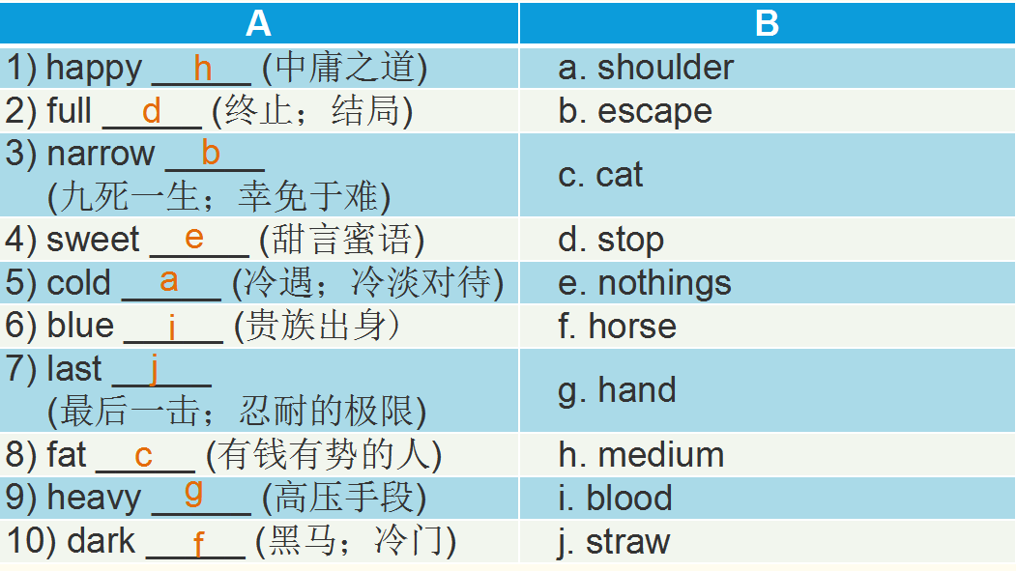
Exercise 6-A

Slide 66
Exercise 6-B
1）narrow escape 2) cold shoulder 3) fat cats 4) last straw 5) full stop 6) blue blood
7) heavy hand 8) dark horse 9) happy medium 10) sweet nothings

Slide 67
Exercise 7-A
1) c 2) d 3) d 4) a 5) d 6) a 7) b 8) c

Slide 68
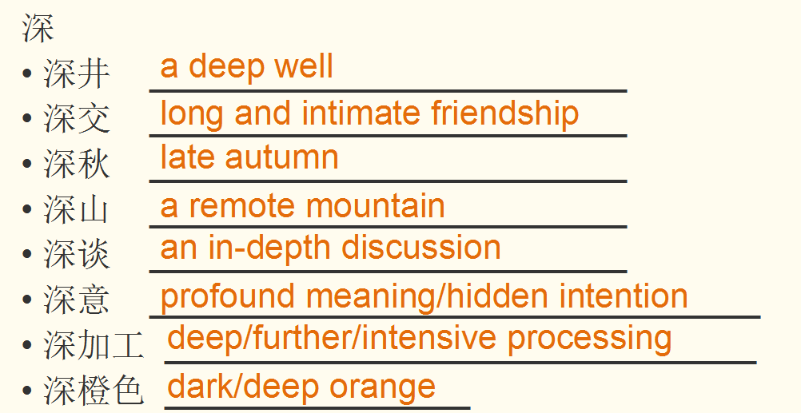
Exercise 7-B

Slide 69
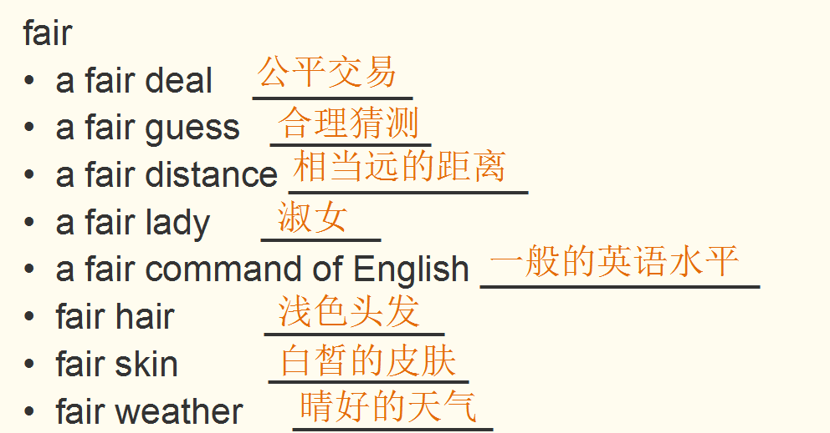

Slide 70
Exercise 8
1) 她双眼闪着梦幻般的光芒，面颊直泛桃红，脸上露出幸福的神色和几分甜蜜的怀想。
2）人们开始涌入办公室找他，有的欣喜若狂，有的尖声厉词，有的满怀敌意，有的激动不已。
3） 证券交易所里行情涨跌，像飓风，像山崩，像雪暴，像冰川和火山，而经纪人办公室里所发生的一切就是这些自然力量的缩影。
4） 他就像一台高速运转、精密而强大的机器那样工作着——精神绷紧到最大限度，开足马力，准确精密，从不犹豫，言语、决策和行动都像机械装置那般，正确无误，准备充分，反应迅速。
5） 麦克斯韦尔站在办公桌边，手里满是电报和备忘便条，右耳朵上夹着一支自来水笔，头发一缕缕凌乱地垂在额前。

Slide 71
Exercise 9
The artistic achievement of A Dream of Red Mansions, so to speak, has attained an unimaginable sublimity. It is outstanding with its rigorous structure, vivid speeches, and above all, the striking images. The characters in the book number as many as over 400. Not only have Jia Baoyu, Lin Daiyu and a dozen other main characters become household classical literary figures, but a good number of minor roles, some of whom are only mentioned in passing, are also distinctive and lifelike. The artistic achievement of the novel is so extraordinary that it can hardly be rivaled even among world-famous literary works.

Slide 72
Words and phrases of Text B Unit 5 expel v. ~ sb/sth (from sth) 1, to officially make sb leave a school or an organization 把…开除（或除名） She was expelled from school at 15. 她15岁时被学校开除了。 Olympic athletes expelled for drug-taking 因服禁药被取消比赛资格的奥运会运动员 2, to force sb to leave a country 驱逐出境 Foreign journalists are being expelled. 外国记者被驱逐出境。 3, (technical 术语) to force air or water out of a part of the body or from a container 排出；喷出 to expel air from the lungs 用力呼出肺里的气

Slide 73
phobia n. 1, a strong unreasonable fear of sth 恐怖症，恐惧症（无名的极度恐惧） He has a phobia about flying. 他对飞行有恐惧症。 2, -phobia (in nouns) a strong unreasonable fear or hatred of a particular thing （构成名词）对…的恐惧症 claustrophobia 幽闭恐惧症 xenophobia 恐外症, 仇外
flee v. [无被动态] ~ (from) sb/sth | ~ (to…/into…) to leave a person or place very quickly, especially because you are afraid of possible danger 迅速离开；（尤指害怕有危险而）逃避，逃跑 1, [单独使用的动词] a camp for refugees fleeing from the war 收留战争难民的难民营 He fled to London after an argument with his family. 他与家人争吵以后离家去了伦敦。 She burst into tears and fled. 她突然哭了起来，跑开了。 2,[动词 + 名词短语] He was caught trying to flee the country. 他试图逃离该国时被抓住了。

Slide 74
raging adj. [只用于名词前] 1, (of feelings or emotions 感觉或情绪) very strong 强烈的 a raging appetite/thirst 极强的食欲；口渴难耐 raging jealousy 强烈的忌妒心 2, (of natural forces 自然力) very powerful 极其强大的；猛烈的 a raging storm 狂风暴雨 The stream had become a raging torrent. 小溪变成了一条汹涌的急流。 The building was now a raging inferno. 这座大楼现在正烈焰熊熊。 3, (of a pain or an illness 疼痛或疾病) very strong or painful 很严重的；很痛苦的 a raging headache 剧烈的头痛 4, very serious and causing strong feelings 严重的；激发强烈感情的 His speech has provoked a raging debate. 他的演讲激起了激烈的争论。

Slide 75
retort v. & n. v. to reply quickly to a comment, in an angry, offended or humorous way （生气或幽默地）反驳，回嘴 1, [动词 + 直接引语] ‘Don't be ridiculous! ’ Pat retorted angrily. “别荒唐了！”帕特生气地回答道。 2, [动词 (+ that从句)] Sam retorted that it was my fault as much as his. 萨姆反驳说我和他同样有错。 n. a quick, angry or humorous reply （生气或幽默的）回应，反驳 She bit back (= stopped herself from making) a sharp retort. 她克制住了自己，没有尖刻地反驳。

Slide 76
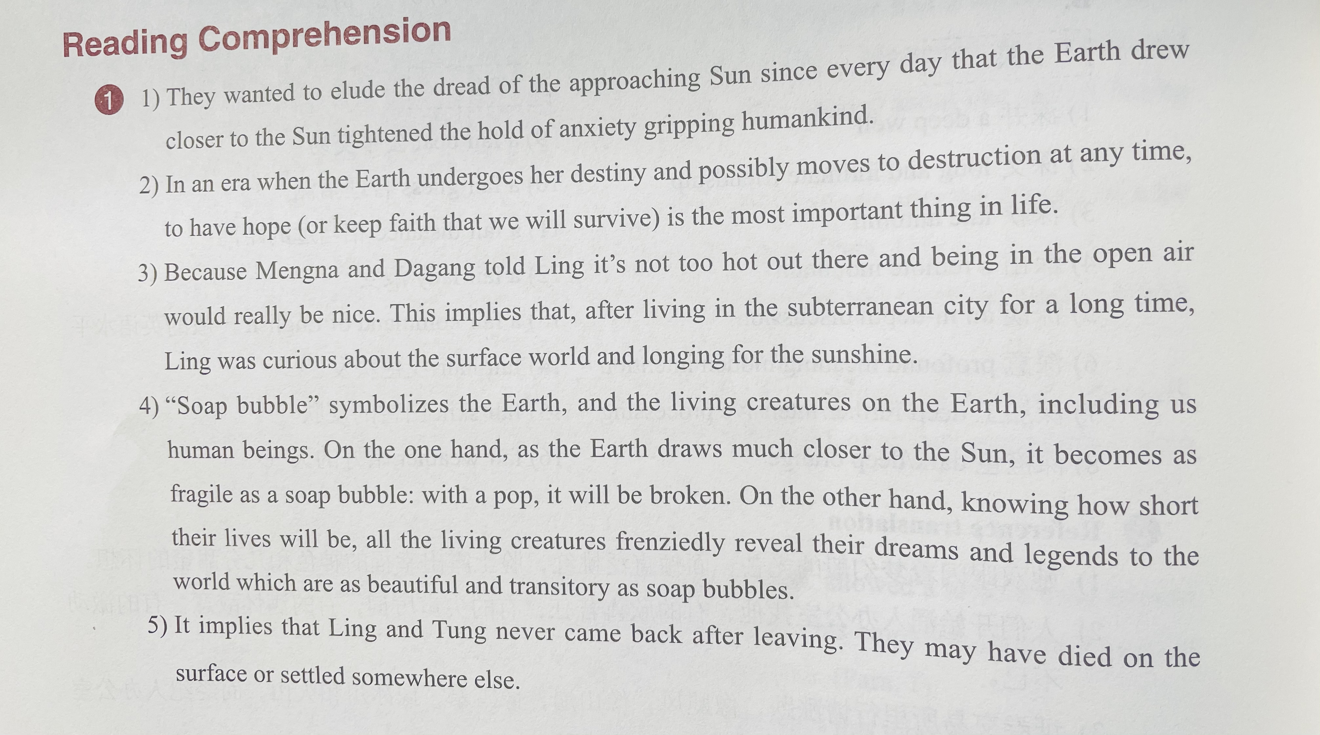

Slide 77
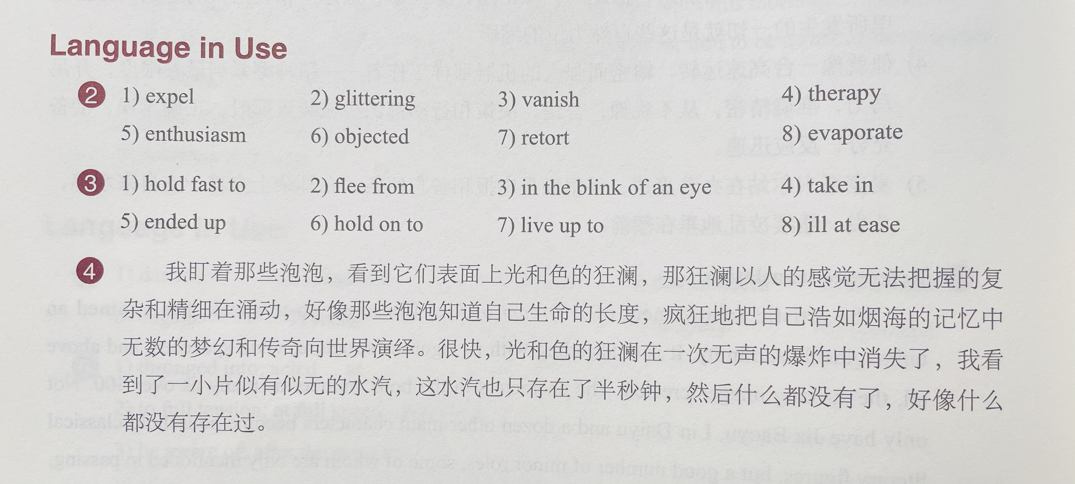

Slide 78



Good Luck!

